Slide 1

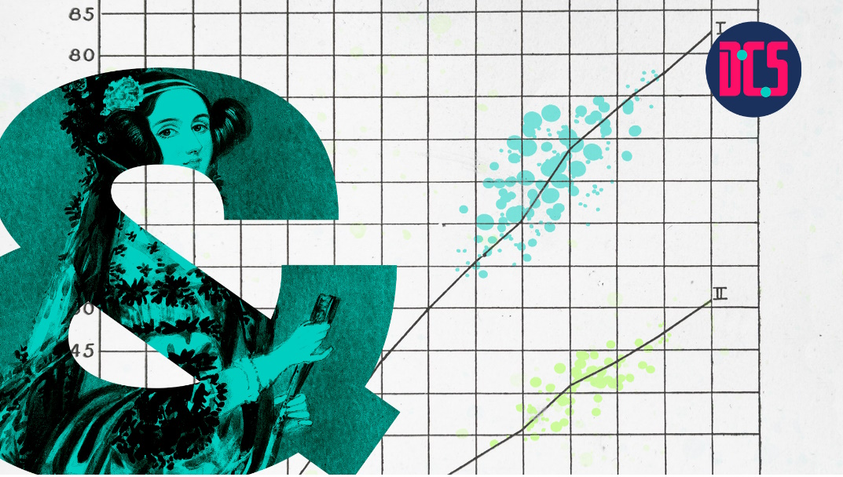
Regression & Mixed-Effects Modelling with R
Fang Jackson-Yang & Aislinn Keogh
29 April 2025

Slide 2
Course outline
Session 1. Simple Regression; Individual Difference; Intro to Linear mixed-effect models (LMMs)
Session 2. LMMs (lmer); Generalised LMMs (glmer)
Session 3. Practical
Session 4. Ggeneralised LMMs continued; Model assumptions and diagnostics
Session 5. Practical

Slide 3
Session 1 Roadmap (today)
1. Get to know the data
2. Simple regression models with continuous outcome – lm()
2.1 One predictor
2.2 Two predictors with interaction
3. Dealing with individual difference
3.1 Alternative
3.2 LMMs

Slide 4
Simple Regression

Slide 5


Regression in Action
Simulated data based on a real case
A secondary school in Glasgow were considering purchasing a new online APP for teaching vocabulary in language classes.
They tested the effectiveness of the course on 40 students over 10 weeks.
How effective was the course? Worthy investing or not?

Slide 6
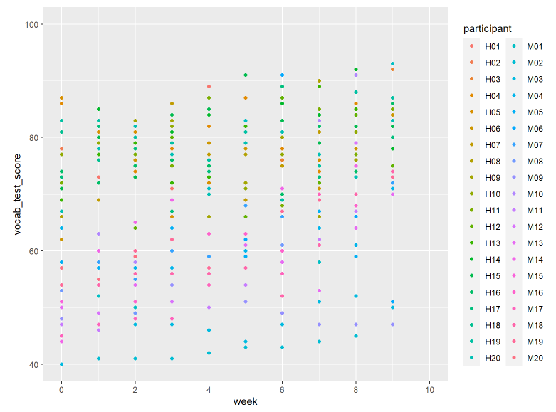
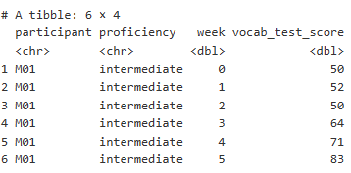
Check Our Data

Slide 7
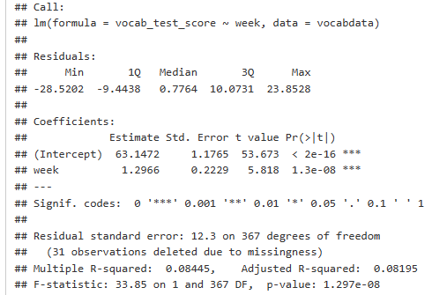
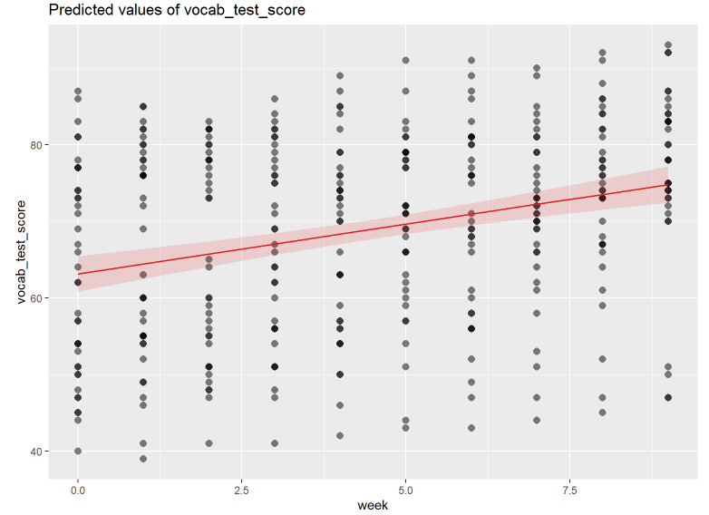
2.1 Simple Regression: One Predictor
Simple regression with one predictor
Notes:
Continuous predictor:
Centre it: to make intercept meaningful
Standardise it when:
If the scales of our variables are arbitrary.
Example: A sum score of questionnaire items answered on a Likert scale.
A unit here would equal moving from a 2 to 3 on one item.
This is not especially meaningful (and actually has A LOT of associated assumptions)
If we want to compare the effects of variables on different scales
If we want to say something like, the effect of x1
is stronger than the effect of x2, we need a common scale.

Slide 8
2.1 Simple Regression: One Predictor
Intercept: the expected value of y when x = 0.
Slope: estimate for the number of units of increases in Y on average, as x increases by one unit
Simple regression with one predictor
Overall quality of the model

Slide 9
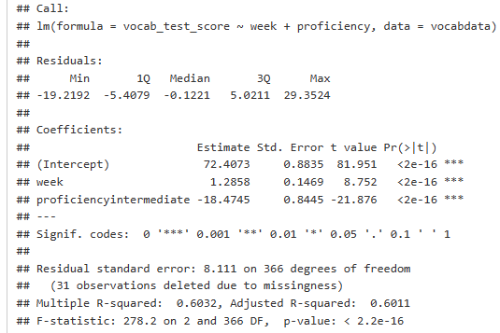
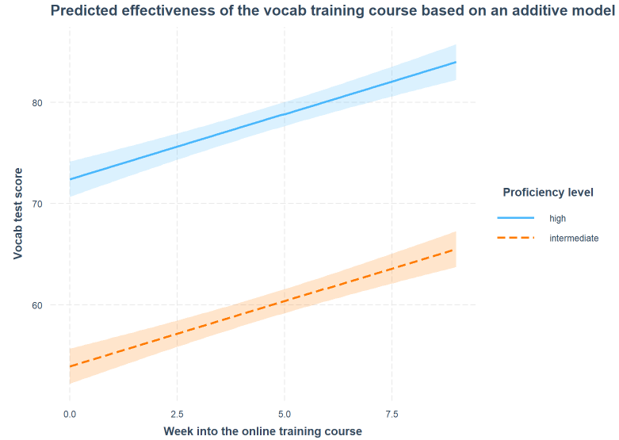
2.2(a). Simple Regression: Two Predictors
Additive model
Notes:
Multiple regression: when we include multiple predictors, those predictors are likely to correlate.
Thus, a linear model with multiple predictors finds the optimal prediction of the outcome from several predictors, taking into account their redundancy with one another
Adjusted r-square
What does holding constant mean?
- Refers to finding the effect of the predictor when the values of the other predictors are fixed
- It may also be expressed as the effect of controlling for, or partialling out, or residualizing for the other x’s
- With multiple predictors lm isolates the effects and estimates the unique contributions of predictors.

Slide 10
2.2(a). Simple Regression: Two Predictors
Intercept: the expected value of y when X1 = 0, and X2 is at its reference category.
Slope: expected change of y on average as X1 increases by one unit.
Slope: expected change of y when X1=0 and X2 changes from its reference category to another category.
Additive model

Slide 11

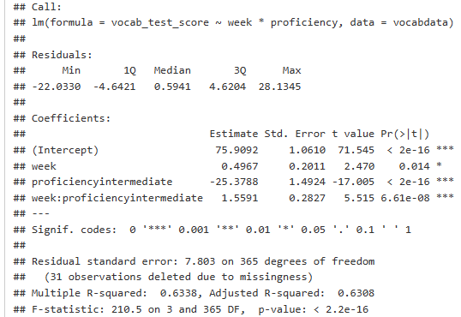
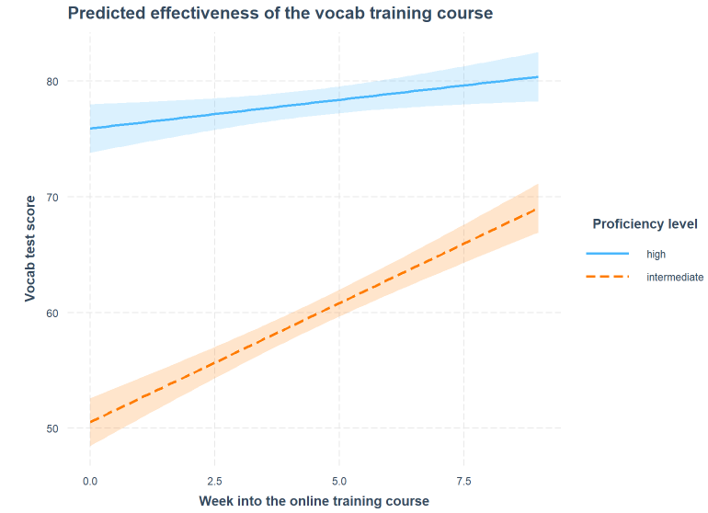
2.2(b). Simple Regression – Two Predictors
Interactive model
identical

Slide 12
2.2(b). Simple Regression – Two Predictors
Intercept: the expected value of y when X1 = 0, and X2 is at its reference category.
Slope: expected change of y on average as X1 increases by one unit, when X2 is in its reference category.
Slope: expected change of y when X1=0 and X2 changes from its reference category to another category.
Interactive model
Slope: difference between the slope (rate of change) of the two regression lines

Slide 13
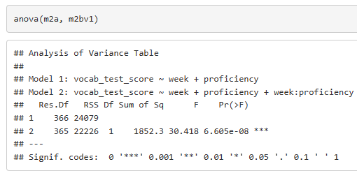
2.2(c). Model comparison
Which model is better? How can we tell?

Slide 14
Individual Difference

Slide 15
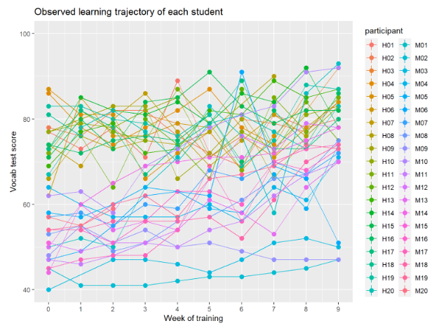
Recall the Data and the Regression(model) Plots
Any problems?
Notes:
Note repeated measures

Slide 16

3.1 Deal with Individual Difference
How can we deal with variances stemming from individual difference?
Some thoughts:
Include “participant” as a predictor?
Control for it as a covariate?
A good idea? Why?

Slide 17


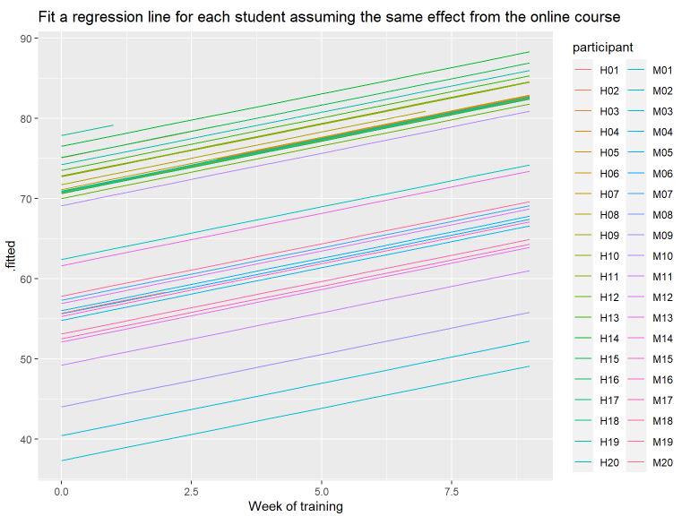
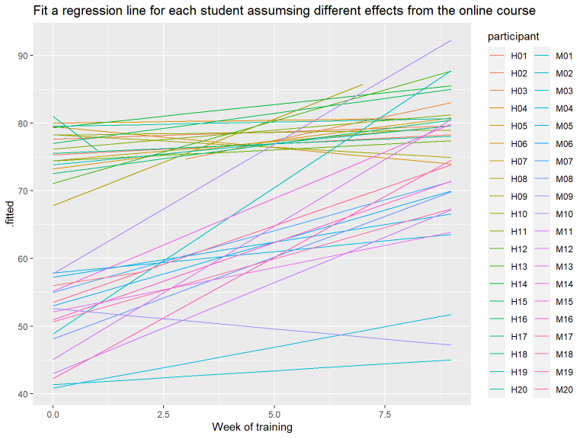
3.1 Deal with Individual Difference

Slide 18
3.2 Individual Difference in LMMs
Recall the structure of a simple regression
Check out the structure of linear mixed-effect models
What differences do you notice?

Slide 19

THANK YOU

